Slide 1
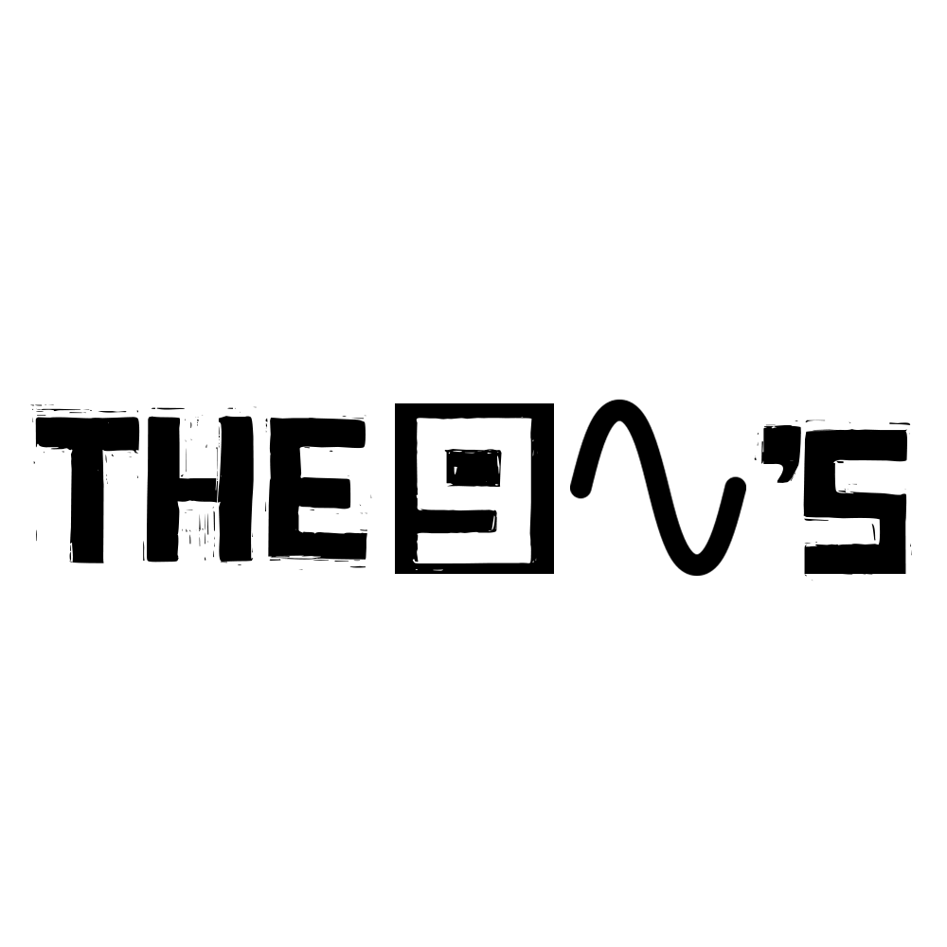


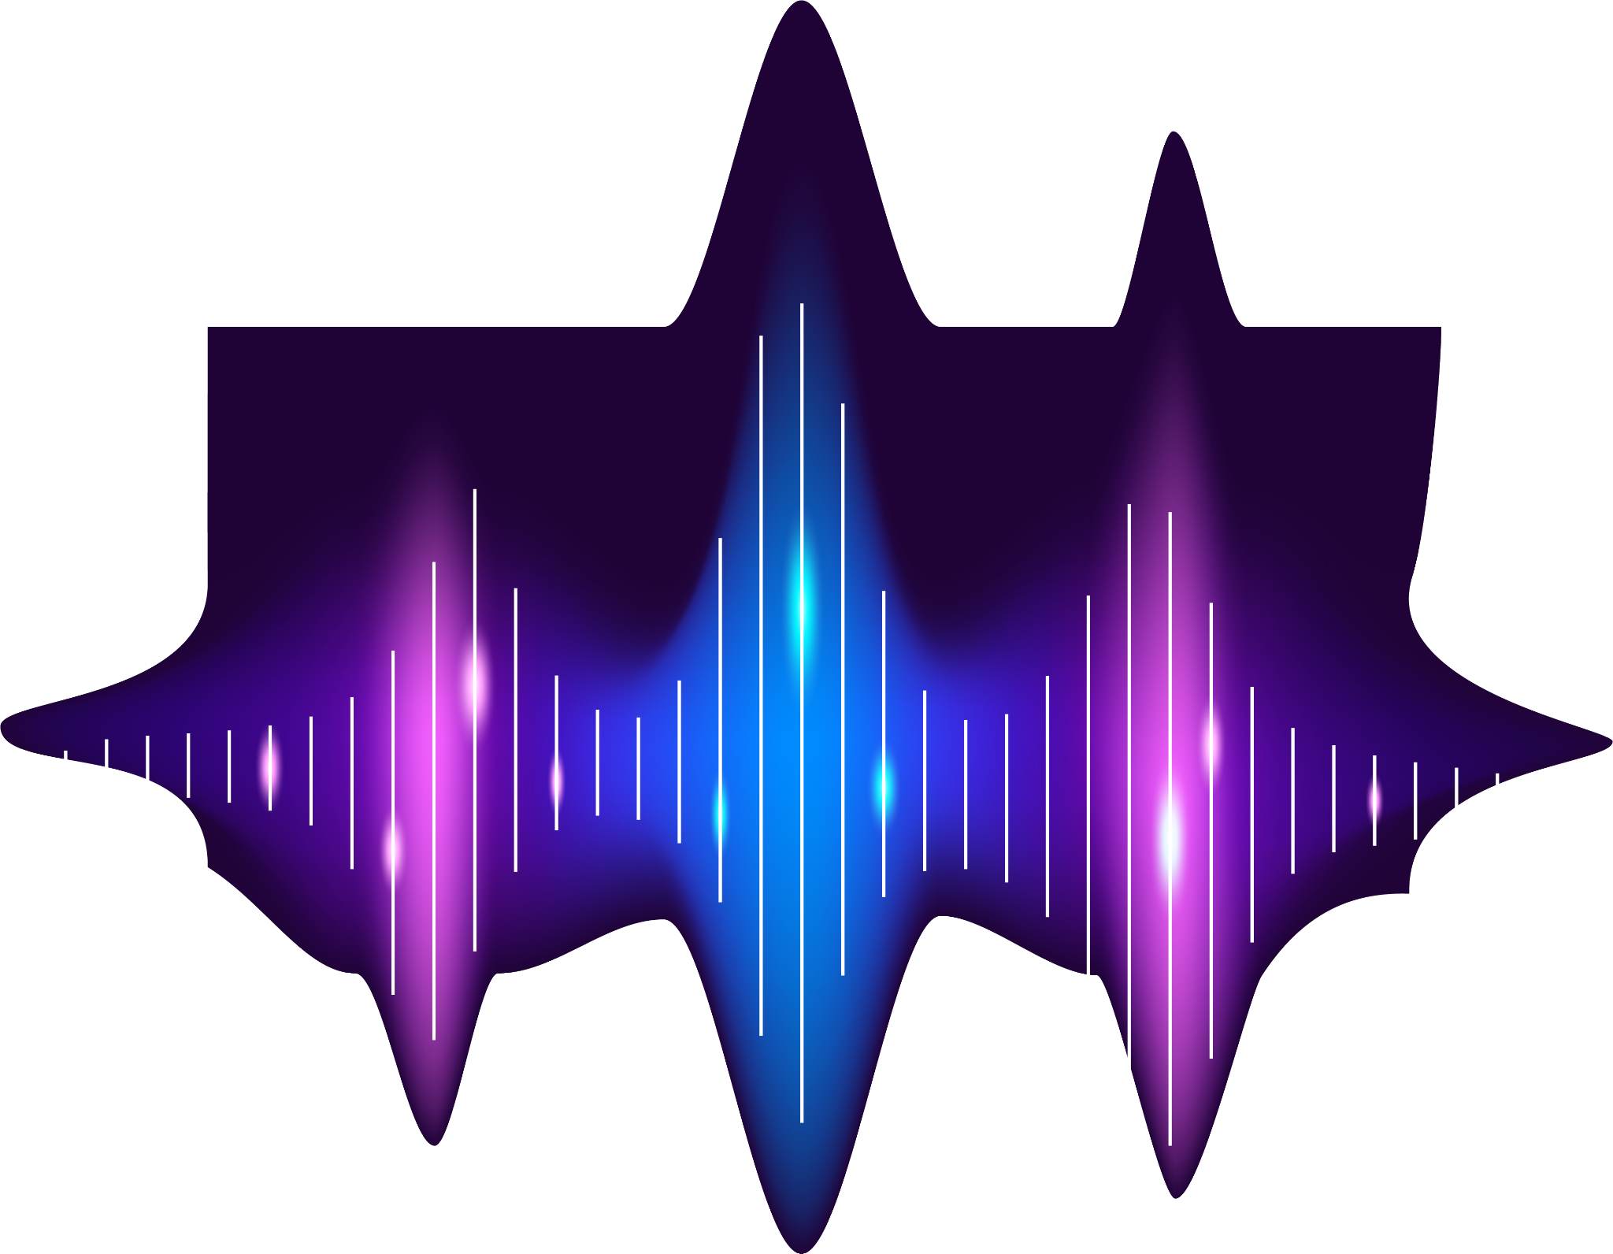
Audio
Denoising
1

Slide 2
Table of contents
01
02
03
04
05
Introduction
Problem Definition
Methodology
06
Implementation
Test & Result
Conclusion & future work
2

Slide 3
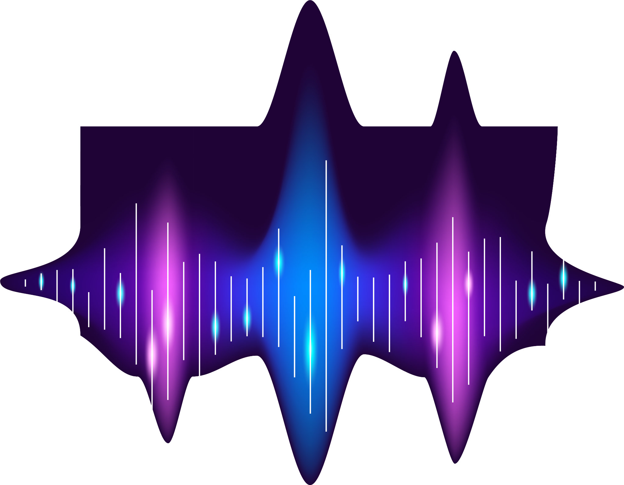
01
Introduction
3

Slide 4
Motivation
01
Improving the quality of audio
Improve Communication
enhancing clarity in recordings
4

Slide 5
Types of noise
01
Gaussian noise
Poisson noise
Salt and Pepper
5

Slide 6
02
Problem definition
6

Slide 7
History of denoising
Methods
02
02
Audio denoising dates back to early 20th century
LMS filter
FIR filter
IIR filter
WAVELET TRANSFORM
Deep learning
7

Slide 8
Methodology
03
8

Slide 9

Methodology
03
continuous Wavelet Transform
PDE & CWT
Discrete Wavelet Transform
Thresholding
FIR & IIR Filters
9

Slide 10
Implementation
04
10

Slide 11
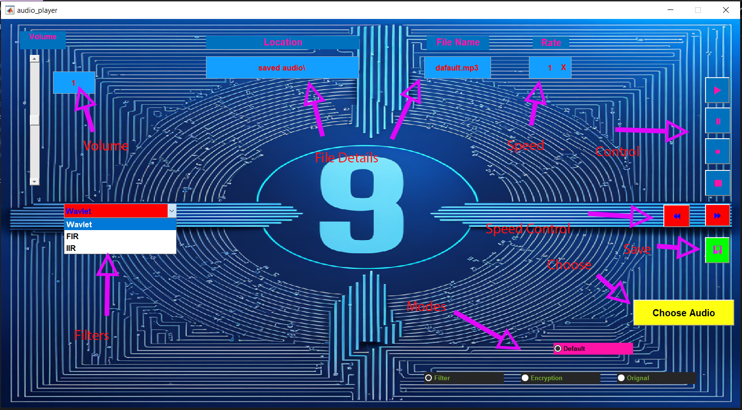
Software
04
11

Slide 12
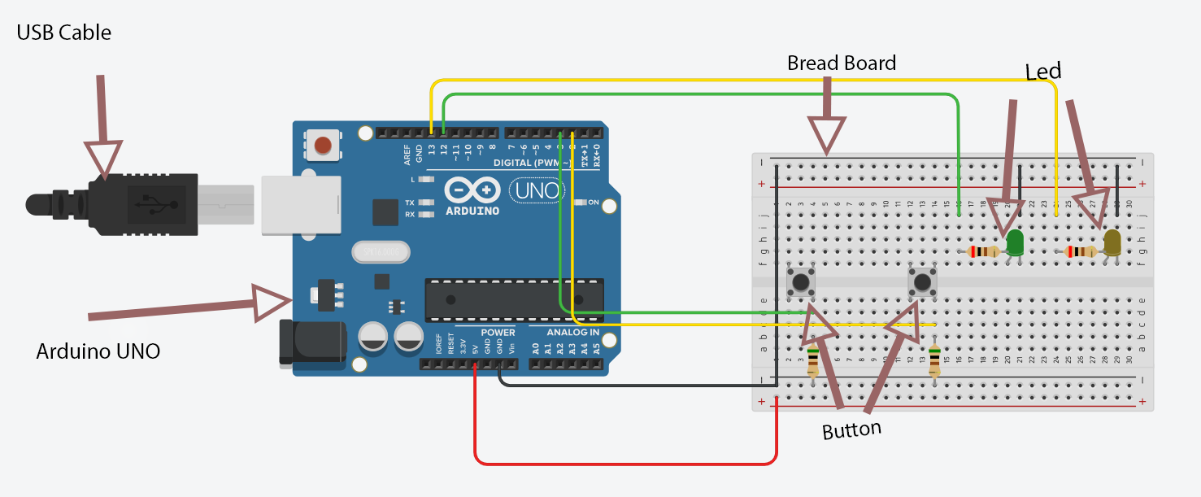
Hardware
04
12

Slide 13
System Description
04
User
Selections Button
LEDs
Arduino
Serial Monitor
Audio Processing Program
Sound File
13

Slide 14
Test & Result
04
14

Slide 15
Experiment Results
04
15

Slide 16
Experiment Results
04
16

Slide 17
05
Conclusion & future work
17

Slide 18
Conclusion
05
The Wavelet is the best method
No difference between FIR and IIR
Highest performance is achieved at normal frequency (40-60) kHz.
18

Slide 19
Future Work
05
Test the other IIR techniques
test the Adaptive LMS algorithm
Bilinear Transform
Impulse & Step Invariance
19

Slide 20
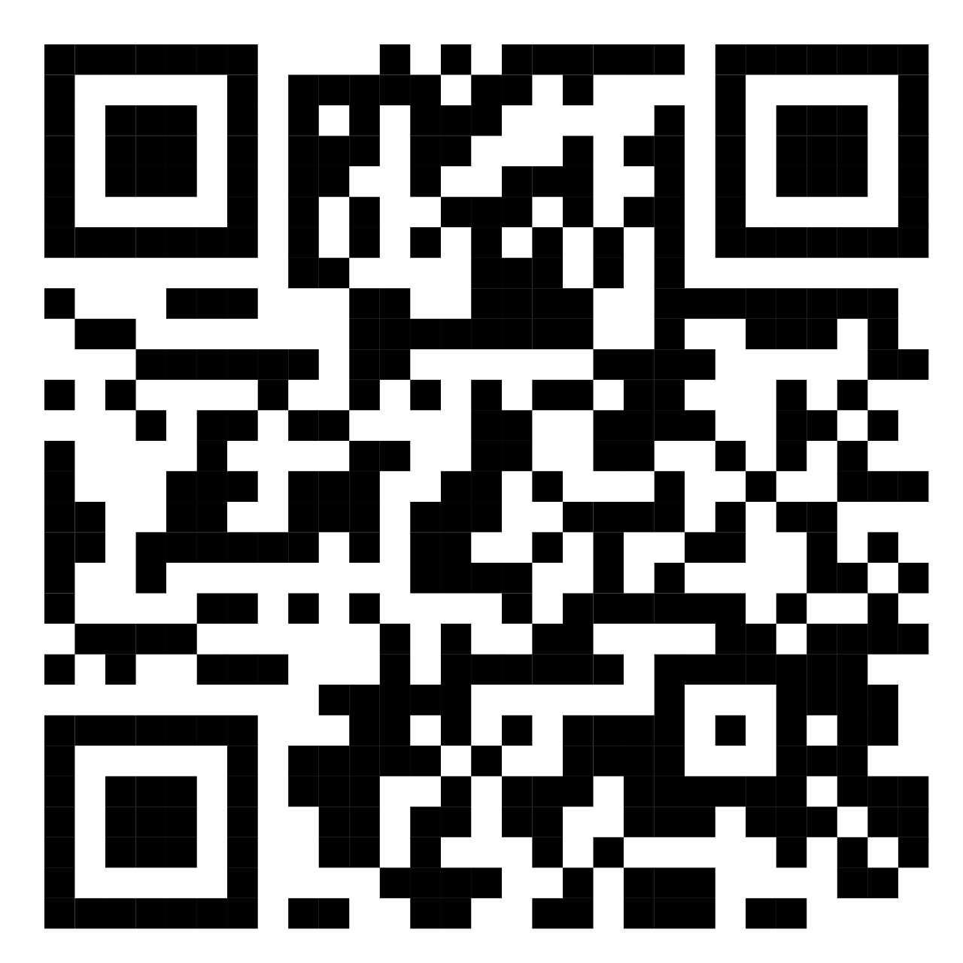
Thanks!
Do you have any questions?
Algorithms
20

